Slide 1
Operator Overloading
By: Richa Jain

Slide 2
Operator Overloading
Like function overloading C++ also supports operator overloading.
C++ contains rich set of operators such as +,-,*,>,<, etc. which work on built in types such as int, char, float to perform various operations.
The + operator can be used to perform addition of two operands a and b which can either be integer, float, double etc. + operation can perform multiple tasks as it can perform addition of any built in data types and hence already overloaded.

Slide 3
However if a,b and c are variables(objects) of user defined data type(class) then the statement c=a+b; will not work as complier do not know how to add two variables(objects) of user defined data type(class). Error will be generated.
In order to make this operation possible we need to overload the + operator by making a function to perform the desired task.
This property of giving additional meaning to the existing operators so that they can work with variables of user defined data type is called operator overloading.
Providing additional meaning to an existing operator does not change the original meaning of operator but it simply extends the functionality of operator.

Slide 4
Operator Overloading
Operator overloading refers giving special meaning to an existing operator.
In order to give additional meaning to the operator , we need to overload it by creating an operator function
An operator function defines the operation that the overloaded operator will perform when used with the objects of a relative class
An operator function can be member or non member(friend function) of a class

Slide 5
Syntax for operator function
When declared inside and defined outside the class
return_type classname:: operator#(argument list)
{
Body of function
}
When defined inside the class
return_type operator#(argument list)
{ body of function}

Slide 6
Contd….
We can overload all C++ operators except the following:
Class member access operator(.,.*).
Scope resolution operators(::)
Size operator( sizeof)
Conditional operators(?:)

Slide 7
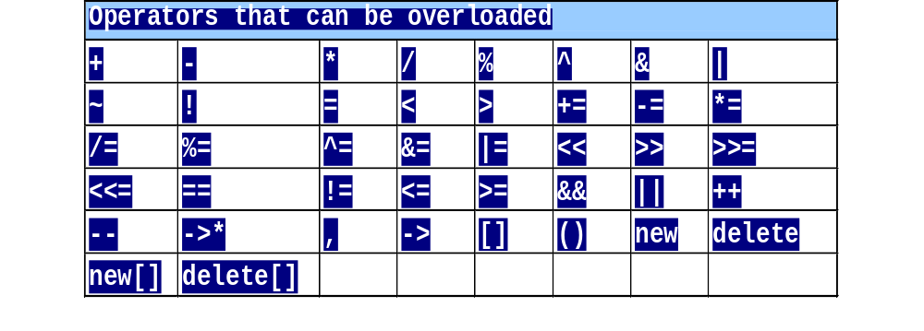
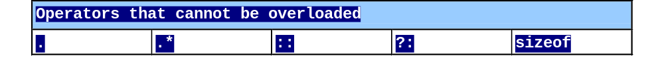
Restrictions on Operator Overloading

Slide 8
The operator keyword is used to overload an operator # which is one of the C++ operator to be overloaded
The complier distinguishes between ordinary member function and operator function of a class by checking the keyword operator.
The name of the operator function is operator#
In order to overload + operator we replace # by +.
The no. of arguments to be passed to operator function depends on whether the operator to be overloaded is unary(++ or --) or binary(+,-,*)

Slide 9
If the operator is unary then the argument list is empty
If the operator is binary the argument list will contain one parameter.
Examples of overloaded operator function:
  void operator ++();
  complex operator +(complex);
  void operator +=(complex);

Slide 10
Operator functions
Operator function must be either member functions (non static)or friend functions.
A basic difference b/w them is:
 | Friend Function | Member Function
Unary Operator | 1 | 0
Binary Operator | 2 | 1

Slide 11
Steps in process of overloading
Create a class that defines data types that is to be used in the overloading operation.
Declare the operator function operator op() in public part of the class. It may be either member function or a friend function.
Define the operator function to implement the required operation.

Slide 12
Types of Operator
Unary operator
Binary operator
Notes:
Student Book

Slide 13
Operator invocation
Overloaded operator functions can be invoked (for unary operator) as:
op x or x op
Can be interpreted as:
(For unary operator)
x or y
(for Binary operator)
operator op (x)
op is operand and x is object
Object

Slide 14
Operator invocation
Overloaded operator functions can be invoked (for binary operator) as:
x op y
Can be interpreted as:
x . operator op (y) → for member function
operator op (x , y) → for friend function

Slide 15
Unary Operators
The unary operators operate on a single operand (-a, +a, --a, a--, ++a, a++)
Notes:
Student Book
The pre and post increment and decrement operators and overloading in different ways. This is because they have a different effect on objects and their values.
e.g. a=14;
cout << a++; // will print 14 and increment a
cout << ++a; // will increment a and print 15

Slide 16
Overloading Unary Operator
Are defined by either a member function that takes no parameter or a non-member function that takes one parameter
Example:
i1.operator -()
or
operator -(i1)
or
-i1

Slide 17
#include<iostream.h>
class space
{
private:
int x;
int y;
int z;
public:
space(int a, int b, int c)
{
x=a;
y=b;
z=c;
}
void display()
{
cout<<x;
cout<<y;
cout<<"\n";
}
void operator-()
{
x=-x;
y=-y;
z=-z;
}
};
void main()
{
clrscr();
space s(10,-20,30);
cout<<"s :";
s.display();
-s;
cout<<"s :";
s.display();
getch();
}

Slide 18
It is possible to overload a unary minus operator using friend function
friend void operator- (space &s); //declaration
void operator- (space &s) //definition
{
s.x = -s.x;
s.y = -s.y;
s.z= -s.z;
}

Slide 19
unary – operator that negates the object of point class
#include <iostream.h>
class point
{
int x, y;
public:
point()
{
x = 0; y = 0;
}
point(int i , int j)
{
x=i; y=j;
}
point operator –( );
void display()
{
Cout<<x<<“\t”<<y;
}
};
// Operator – operator for point class
point point::operator-( )
{
x=-x;
y=-y;
}
int main()
{
point o1(10 , 10);
-o1; //Negate the object
o1.display();
}

Slide 20

Example of overloading Unary operator
int main()
{
//clrscr();
score s1,s2; // object definition
cout<<"\n initial value of s1 object = "<<s1.show();
cout<<"\n initial value of s2 object = "<<s2.show();
++s1; //operator function call
++s1; // same as s1.operator++();
++s2;
cout<<"\n final value of s1 object = "<<s1.show();
cout<<"\n final value of s2 object = "<<s2.show();
getch();
return 0;
}
#include<iostream.h>
#include<conio.h>
using namespace std;
class score
{
private: int val;
public: score()
{ val=0;}
void operator++() //operator function definition
{ val= val+1; }
int show()
{ return (val); }
};

Slide 21
Binary Operators
Binary operator works on two operands
(a-b, a+b, a*b, a/b, a%b, a>b, a>=b, a<b, a<=b, a==b)
Notes:
Student Book

Slide 22
Example: Binary Operators
class BinaryExample
{
private:
int m_LocalInt;
public:
BinaryExample(int j)
{
m_LocalInt = j;
}
int operator+ (BinaryExample & rhsObj)
{
return (m_LocalInt + rhsObj.m_LocalInt);
}
};
void main()
{
BinaryExample object1(10), object2(20);
// overloaded operator called
cout << object1 + object2;
}
// ob1 = ob1 + ob2;
equivalent to
ob1 = ob1.operator+(ob2);
Notes:
Ob1.operator + (ob2)……ob1 calling function….and ob2 passed as argument

Slide 23
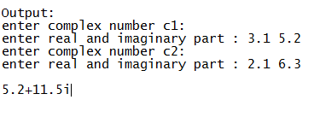
class complex
{
private: float real,img;
public : complex() // default constructor
{ real=img=0.0; }
void read() //read complex number
{
cout<<"\n enetr real and imaginary part :";
cin>>real>>img;
}
complex operator+(complex cc2)// overloaded operator() function '+'
{
complex temp; // default constructor called
temp.real =real+cc2.real;
temp.img=img+cc2.img;
return(temp);
}
void show()
{
if(img>0)
cout<<real<<"+"<<img<<"i"<<endl;
else
cout<<real<<img<<"i"<<endl;
}
};
int main()
{
//clrscr();
complex c1,c2,c3;
cout<<"\nenter complex number c1 :";
c1.read();
cout<<"\nenter complex number c2 :";
c2.read();
c3=c1+c2; // call to the operator function + I and equivalent to c1.operator+(c2)
c3.show();
getch(); return 0;
}

Slide 24
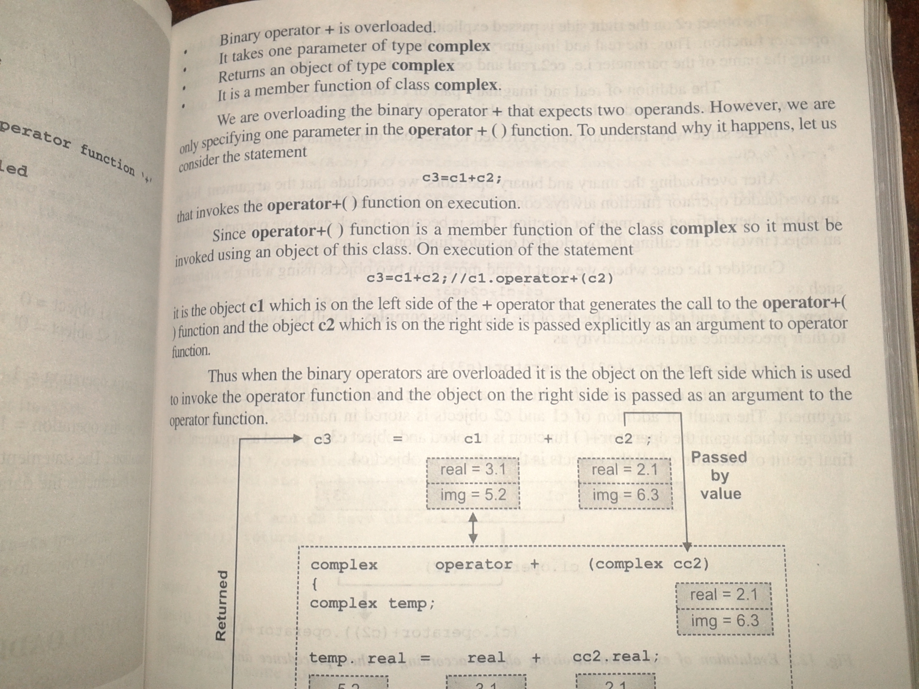
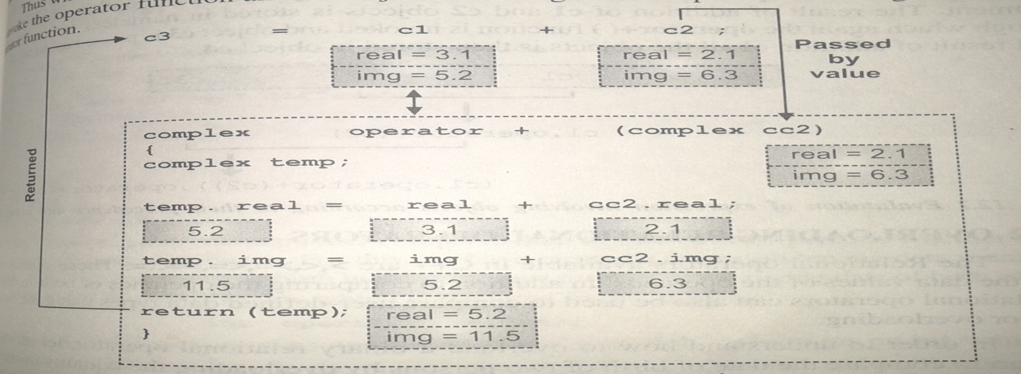

Slide 25
Overloading binary operator using friends
Declaration-
Friend complex operator+(complex, complex);
Definition-
Complex operator+(complex e1, complex e2)
  { complex temp;
  temp.x = e1.x + e2.x;
  temp.y = e2.y + e2.y;
  return (temp);
  }
  Calling
  E3= operator+(e1,e2);

Slide 26
Rules for overloading operators.
Only existing operators can be overloaded. New operators cannot be created.
The overloaded operator must have at least one operand that is of user defined type.
We cannot change the basic meaning of the operator.
Overloaded operators follow the syntax rules of the original operators. They cannot be overridden.

Slide 27
Rules for overloading operators.
There are some operators that cannot be overloaded.
We cannot use friend functions to overload certain operators. Member functions can be used to overload them.
Unary operators overloaded by means of member function, take no explicit arguments and return no explicit values.

Slide 28
Rules for overloading operators.
Binary operators overloaded through a member function take two explicit arguments.
When using binary operators overloaded through a member function, the left hand operand must be an object of the relevant class.

